Slide 1

Data Management Training Clearinghouse
An Overview
Karl Benedict (University of New Mexico) & Nancy Hoebelheinrich (Knowledge Motifs LLC)
Image from Shutterstock
http://bit.ly/dmtc-2019-ALISE

Slide 2

Presentation Outline
Introduction to the DMTC
Demonstration of the DMTC search process and interface
Demonstration of the resource submission process
Image from Shutterstock

Slide 3

Data Management Training Clearinghouse
Background
Image from Shutterstock

Slide 4
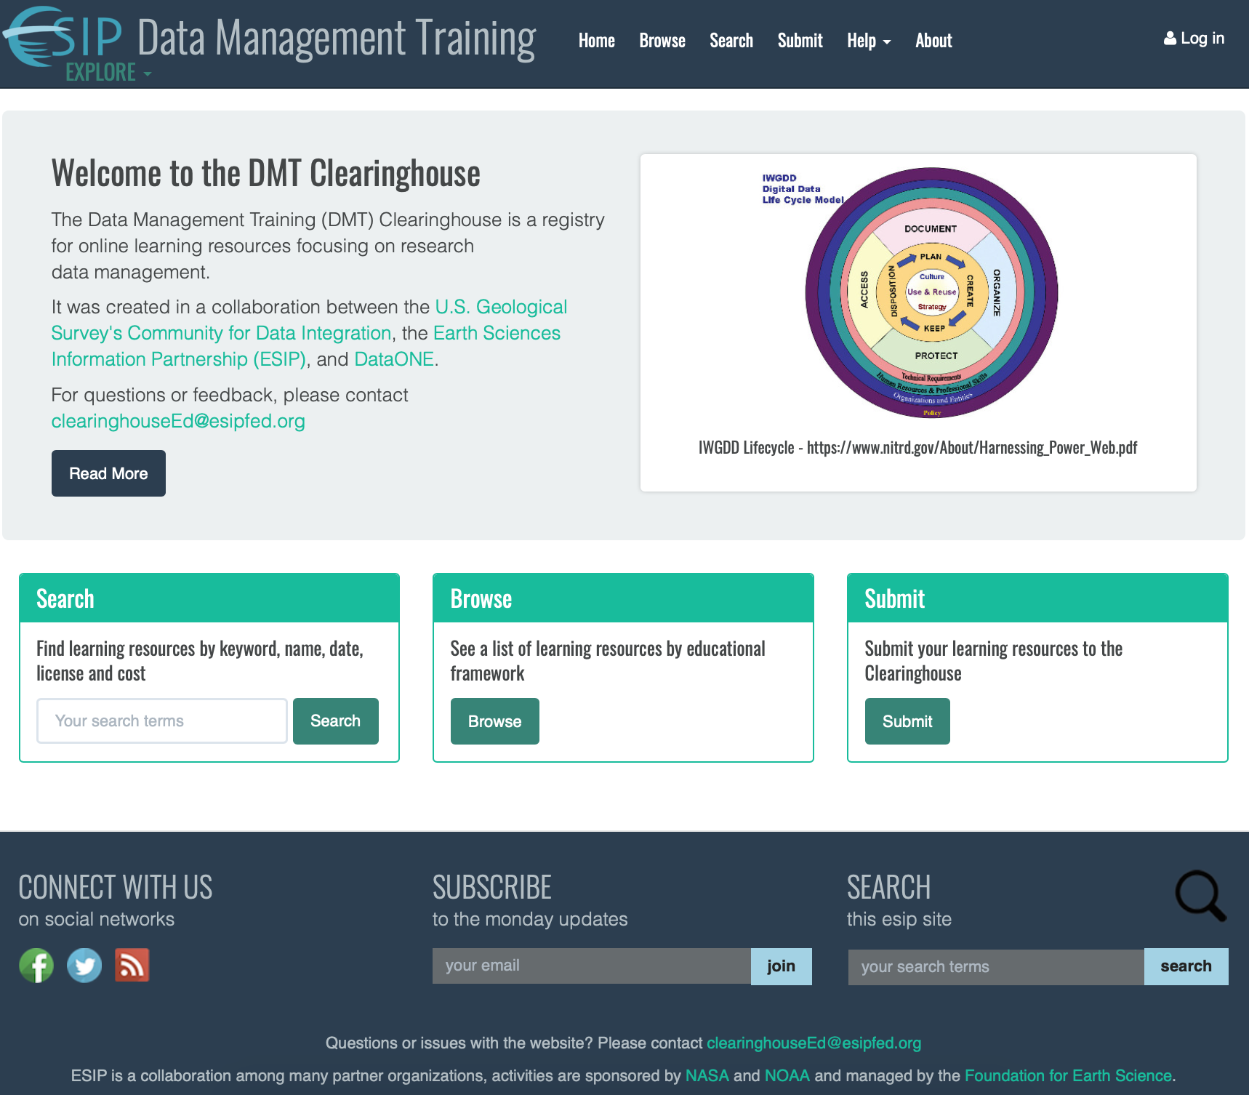
Data Management Training Clearinghouse Background
Work Started 2015
First Content in 2016
Supported by USGS CDI, DataONE, and the Earth Science Information Partners (ESIP)

Slide 5
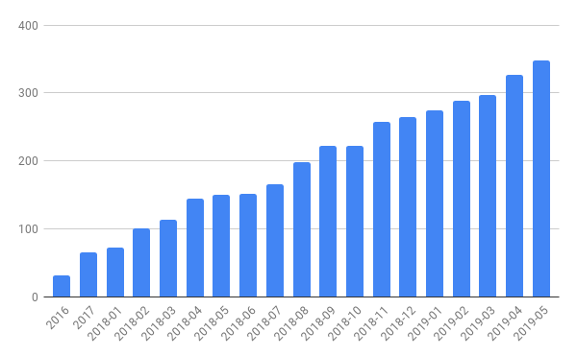

Continued Development Supported by IMLS
Number of Training Resources in the DMTC
Original development
IMLS Project (continuing)
353 Resources
To date
July 2018 – Start of 3 year project to enhance the DMTC
Quantity of Content
Diversity of Content
Metadata/Search
Assessment
Outreach
With addition of a needed platform migration

Slide 6
Content Diversity
Data Keywords
Agricultural data | Nutrition data
Biological data | Ocean data
Coastal data | Open data
Fossil data | Organismal data
Genomic data | Paleontological data
Food security data | Social science data
Geoscience data | Specimen data
Geospatial data | Swath bathymetry data
Gridded data | Tabular data
Linked data | Taxonomic data
Marine data

Slide 7
Metadata & Search
Existing Metadata Elements | Additional Elements
Contributor Type | Educational Framework Target
Intended Time to Complete | Educational Framework Target URL
Educational Purpose of Resource | Country of Origin
Type of Learning Resource | Type of Credential Offered if Any
Targeted Audience for Resource | Resource Modificaiton Date
Content Usage Information | Persistant Personal Identifiers for People
Cost to Access | Type of Persistant Personal Identifier
Media Type | Supported Accessibility Features
Credential Status | Narrative Summary of Accessibility Features
Content License URL
Educational Framework
Educational Framework Node
Description of Educational Framework Node
Link to Educational Framework Node Explanation
Expand metadata model beyond core
Refine search capabilities based on updated model and user feedback

Slide 8
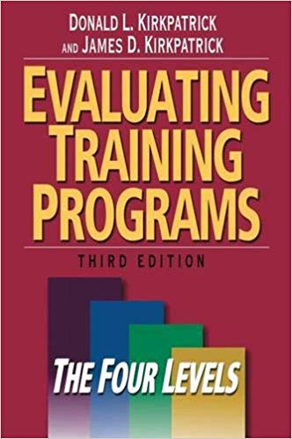
Assessment
Behavior
Learning
Reaction
Results
Key Performance Indicators
Clearinghouse
Usability
Use
Content
Editorial
Peer-review
Usage
Target Behaviors
Learning Objectives
Performance Standards
Donald L. Kirkpatrick and James D. Kirkpatrick. 2006 Evaluating Training Programs: the Four Levels. 3rd Ed. Berrett-Koehler Publishers, Inc.

Slide 9
Outreach
Conferences
Workshops
Webinars
Data Help Desk

Slide 10
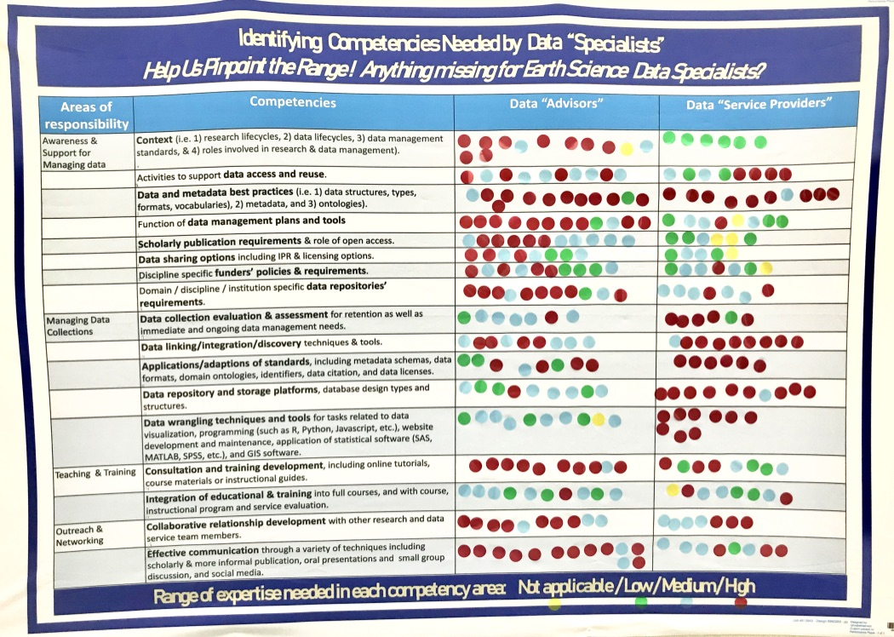
Related work
Identifying core knowledge, skills, and competencies
Informing assessment planning
Contributing an American Geosciences Institute Career Compass
Survey: http://bit.ly/data-competencies

Slide 11

Platform Migration
FROM: https://devcollaborative.com/blog/drupal-7-8-support-ends-nov-2021-whats-nonprofit-do
Currently on Drupal 7
Drupal 7 & 8 End-of-Life: November 2021
Decouple Conjoined ESIP Web Assets – DMTC and Commons
Build for Long-Term Sustainability
Client Applications
Web Services – REST API
+
Data Management

Slide 12

Data Management Training Clearinghouse
Browse & Search

Slide 13
Data Management Training Clearinghouse
Resource Description & Publication Workflow

Slide 14

Data Management Training Clearinghouse
How You Can Help and Evaluation
Image from Shutterstock

Slide 15

How you can contribute
Metadata & Search Working Group - assessing the current metadata schema used in the Clearinghouse and the search and browse capabilities built upon those metadata.
Assessment Working Group - prioritizing areas for assessment of the Clearinghouse and the training resources.
Editorial Team - contributing to the publication workflow for submitted training material metadata.
Contributing New Materials - identifying and providing metadata for integration into the Clearinghouse.
Presentation Evaluation:
http://bit.ly/DMTC-ws-feedback

Slide 16
Backup Skills Poster Data

Slide 17
Areas of Responsibility | Competencies | Data "Advisors" |  |  |  | Data "Service Providers"
 |  |  | (e.g., "curators") |  |  |  | (e.g., "data librarians")
 |  | High | Medium | Low | Not applicable | High | Medium | Low | Not applicable
Awareness & Support for Managing data | Context (i.e. 1) research lifecycles, 2) data lifecycles, 3) data management standards, & 4) roles involved in research & data management). [Row 1] | 9 | 2 |  | 1 |  |  | 6
 | Activities to support data access and reuse. [Row 2] | 4 | 6 |  |  | 4 | 2 | 2
 | Data and metadata best practices (i.e. 1) data structures, types, formats, vocabularies), 2) metadata, and 3) ontologies). [Row 3] | 10 | 1 | 1 |  | 9 | 1
 | Function of data management plans and tools [Row 4] | 10 | 1 | 1 |  |  | 3 | 3 | 1
 | Scholarly publication requirements & role of open access. [Row 5] | 5 | 6 |  |  |  | 1 | 3 | 2
 | Data sharing options including IPR & licensing options. [Row 6] | 3 | 3 | 2 |  |  | 2 | 2 | 1
 | Discipline specific funders’ policies & requirements. [Row 7] | 4 | 3 | 3 |  | 1 | 3 | 2 | 1
 | Domain / discipline / institution specific data repositories’ requirements. [Row 8] | 8 | 2 | 1 |  | 2 | 5
Managing Data Collections | Data collection evaluation & assessment for retention as well as immediate and ongoing data management needs. [Row 9] | 1 | 5 | 1 |  | 5 |  | 4
 | Data linking/integration/discovery techniques & tools. [Row 10] | 4 | 5 |  |  | 8 | 1
 | Applications/adaptions of standards, including metadata schemas, data formats, domain ontologies, identifiers, data citation, and data licenses. [Row 11] | 4 | 1 | 3 |  | 6
 | Data repository and storage platforms, database design types and structures. [Row 12] | 1 | 5 | 3 |  | 9 | 1
 | Data wrangling techniques and tools for tasks related to data visualization, programming (such as R, Python, Javascript, etc.), website development and maintenance, application of statistical software (SAS, MATLAB, SPSS, etc.), and GIS software. [Row 13] |  | 6 | 3 | 1 | 9
Teaching & Training | Consultation and training development, including online tutorials, course materials or instructional guides. [Row 14] | 9 | 1 |  |  | 3 | 2 | 3
 | Integration of educational & training into full courses, and with course, instructional program and service evaluation. [Row 15] | 1 | 6 | 3 |  | 2 | 3 | 2 | 1
Outreach & Networking | Collaborative relationship development with other research and data service team members. [Row 16] | 7 | 3 |  |  | 3 | 4
 | Effective communication through a variety of techniques including scholarly & more informal publication, oral presentations and small group discussion, and social media. [Row 17] | 11 | 2 |  |  | 3 | 4 | 1
Range of expertise needed in each competency area: High (Red)/Medium (Blue)/ Low (Green) /NA (Yellow)
Adapted from Whyte, A., et al, "Annex B: Skills Tables" of "D7.5 Strategy for Sustainable Development of Skills and Capabilities", EOSC pilot, v1.1,
April 29, 2019. | https://eoscpilot.eu/content/d75-strategy-sustainable-development-skills-and-capabilities. |  |  | Last viewed September 17, 2019.
Suggestions for what is missing:
 | See technology trends
 | Common sense
 | Domain knowledge of the specific science domain(s) being served
 | Providing consultation on the best dataset for a given model, e.g., climate research

Slide 18
Backup Skills Poster Data

Slide 19
Backup Walkthrough of Interface

Slide 20
Data Management Training Clearinghouse
Search Process Workflow to Education Publication Workflow

Slide 21
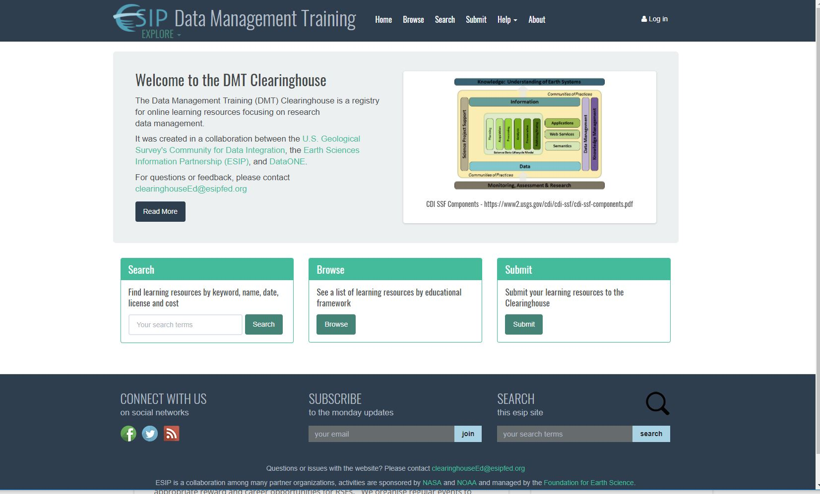
DMT Clearinghouse functionality…
http://dmtclearinghouse.esipfed.org/

Slide 22
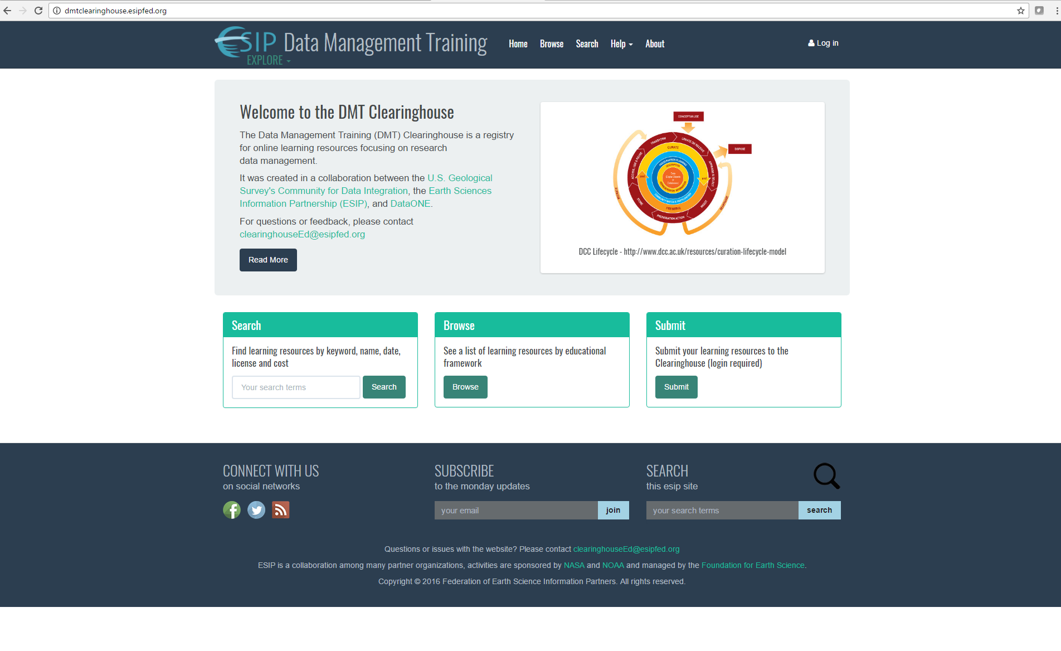
Search Function
Notes:
From Clearinghouse home page

Slide 23
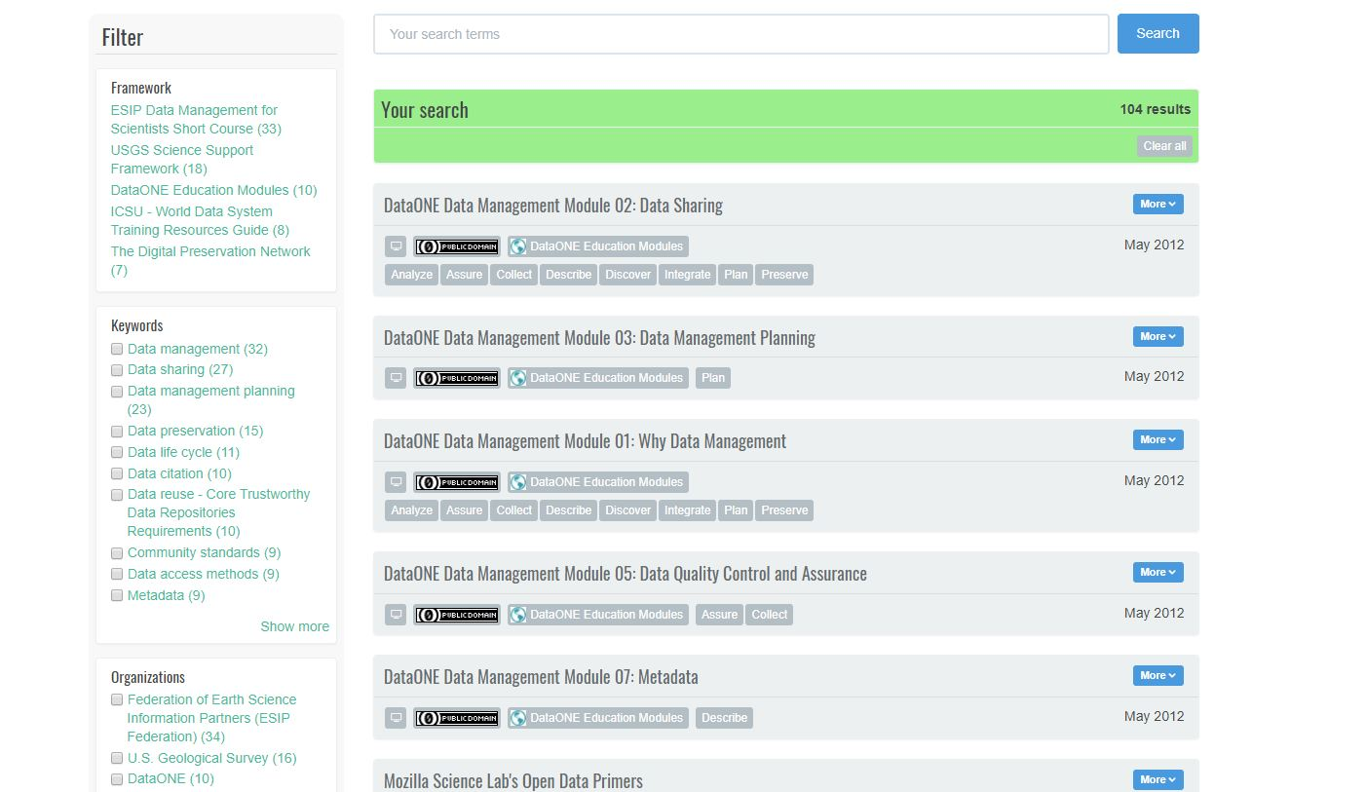
Search Function: Example approaches
You filter
by
pre-set
categories
(“facets”)
You enter your own
search terms
23

Slide 24
Search Process: Approach 1 = You search using your own terms
24

Slide 25
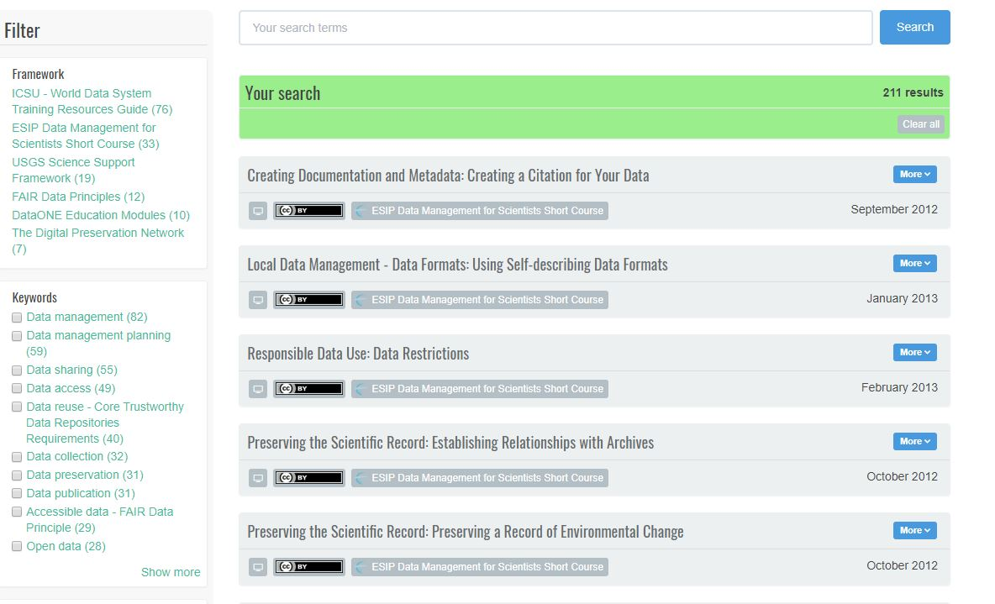
Search Process: Approach 2 = You start by checking boxes within the pre-set categories (“filters”)
25

Slide 26
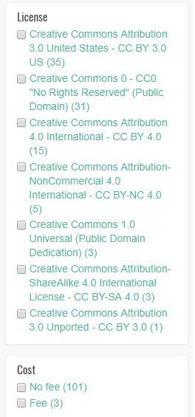
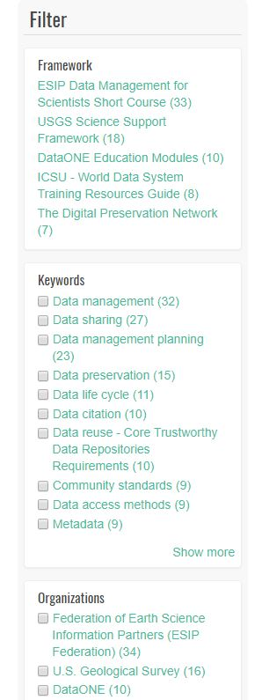
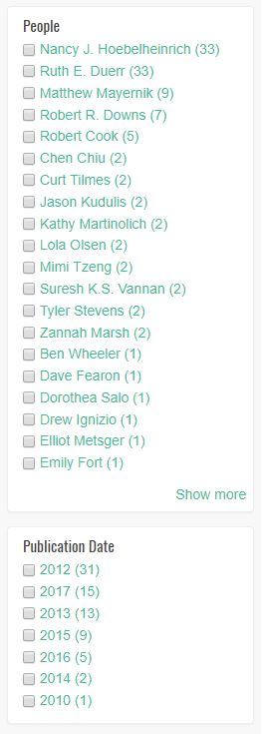
Built-in Search Filters
26

Slide 27

Search Process: Approach 3: Combining Approach 1 & Approach 2 …
27

Slide 28
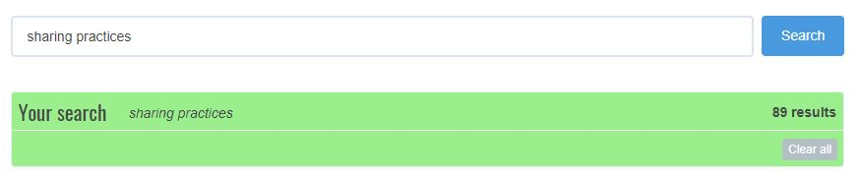
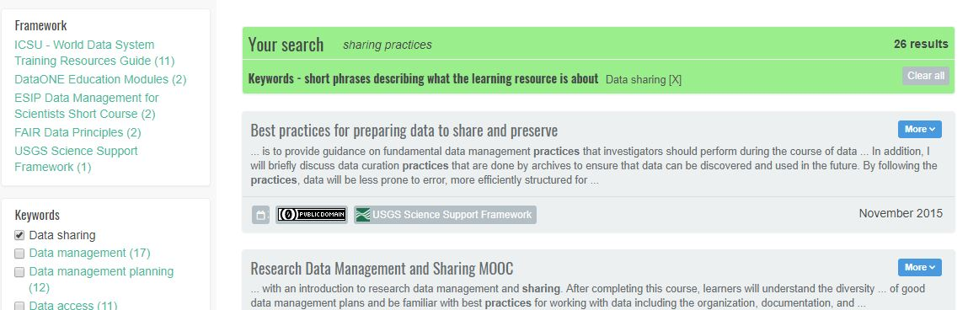
Demonstrating Approach 3: Start by entering your own search term…
Yikes!
… then limiting by Keyword filter…
More precise!
28

Slide 29
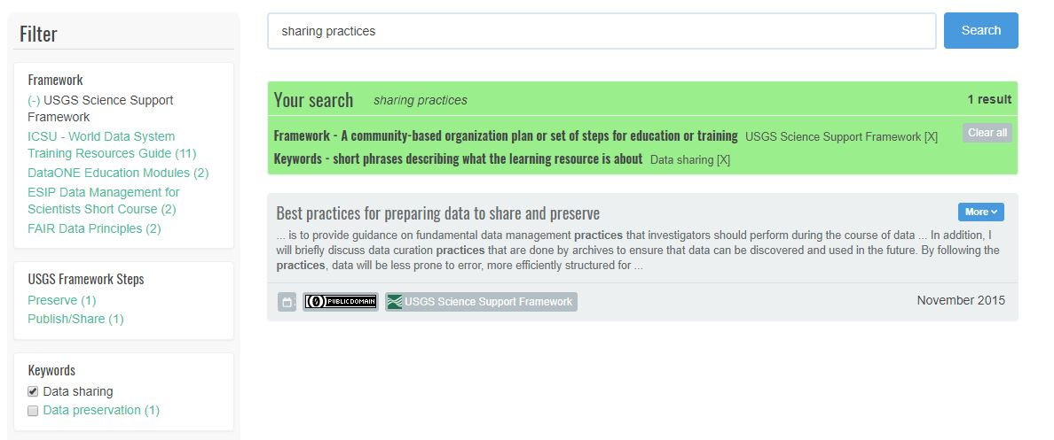
Demonstrating Search: finally, limiting even more by the Framework filter…
Still more precise!
29

Slide 30
Demonstrating Search: however, if too precise, you can either Clear all to start over … or uncheck filters / facets
30

Slide 31
Data Management Training Clearinghouse
Search Results

Slide 32
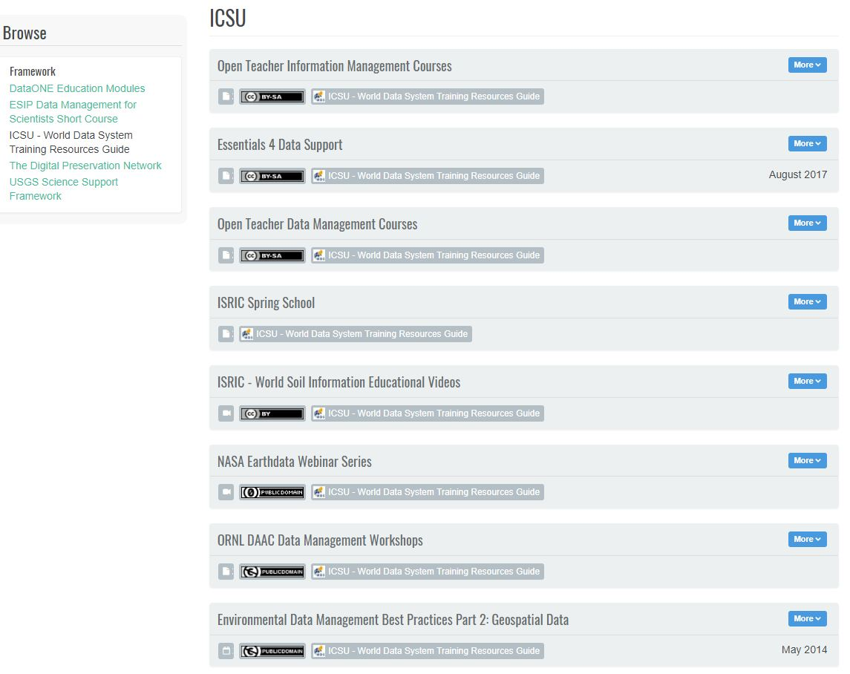
Search Results View -- What does it tell you?
You can either
click on the Title
or the
More
button
to get
more Info

Slide 33
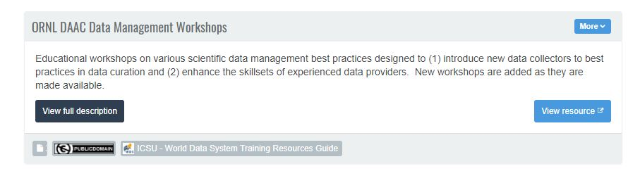
Brief Description -- What does it tell you?

Slide 34
Brief Description -- you want to see more about this one! What next?
Click on the View full description to look at the full metadata … or
the View resource button to go directly to the “landing page” of the resource.
You can either …

Slide 35
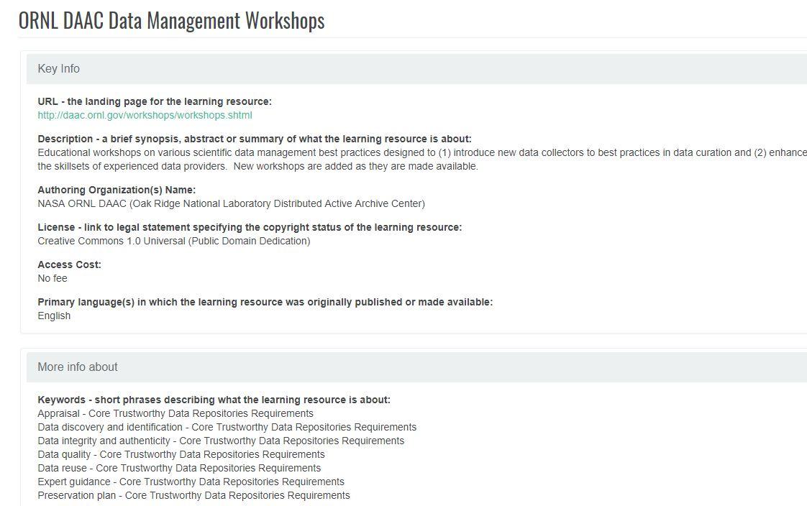
Full Description – 1 of 2
35

Slide 36
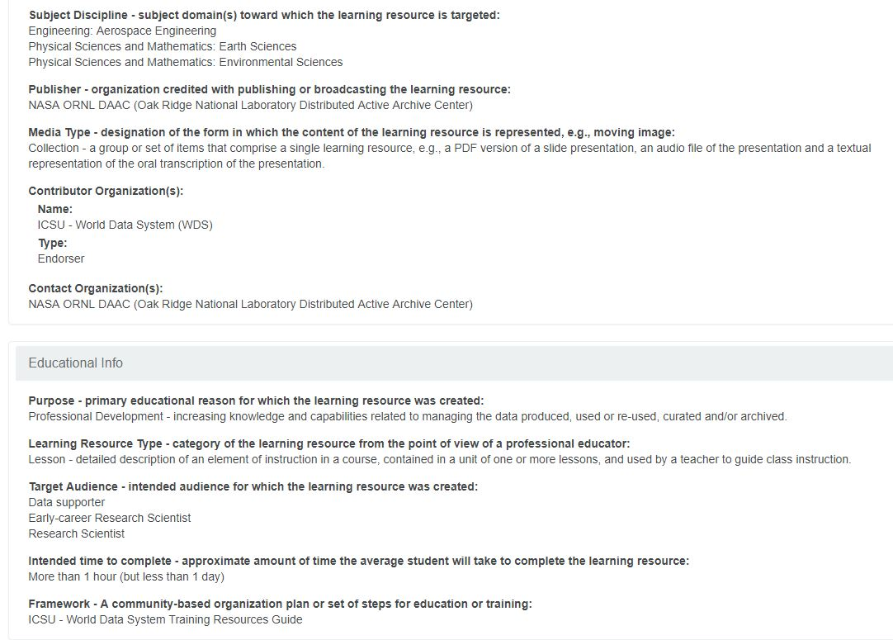
Full Description – 2 of 2
36

Slide 37
Submission backup slides

Slide 38
Current Publication Process
We Invite community volunteers who wish to submit and/or review descriptions of educational resources to the DMTC using existing:
Selection Criteria:
https://github.com/imls-dmt/resources-workflow/blob/master/Nov17_2018_SelectionCriteria.pdf
Tutorial for Submitting Descriptions to the DMTC with suggested workflow:
https://github.com/imls-dmt/resources-workflow/blob/master/Tutorial%20for%20Submitting%20Educational%20Resource%20Metadata.pdf
Metadata input form – using the Dublin Core maintained, and Schema.org endorsed Learning Resource Metadata Initiative schema: http://dublincore.org/specifications/lrmi/
Questions / Interest: email us at: clearinghouseEd@dmtclearinghouse.esipfed.org
Provide contact information and specific interest in the presentation feedback form: http://bit.ly/2019-ESA-feedback
38

Slide 39
“Submit” Function
Notes:
From Clearinghouse home page

Slide 40
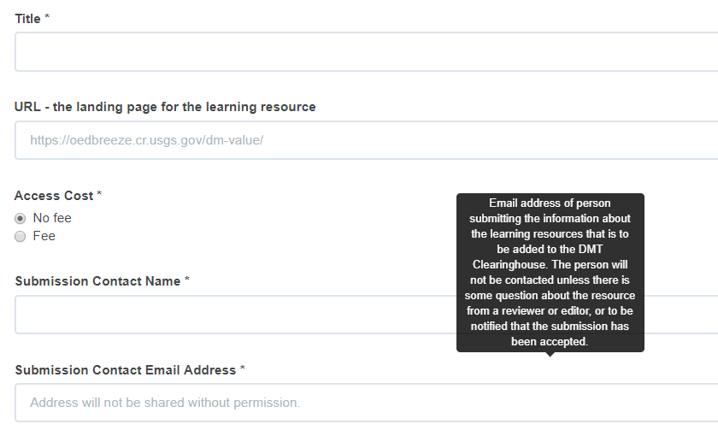
EZ “Submit” Form – no login required
Notes:
From Clearinghouse home page

Slide 41
“Submit” Recommended Information submitted, reviewed & published by logged in user:
Names, Personal & Organizational for Authors and Contributors
Descriptive Information
Educational Context for the Resource
Notes:
From Clearinghouse home page

Slide 42

Current Clearinghouse publication process by role of logged-in user
Task | Submitter | Reviewer | Editor
ID resource
Fill out Required Info
Fill out Recommended Info
Save
Add to Controlled Vocabularies (varies by role)
Submit
Evaluate Appropriateness of Adding Resource
Review / Edit metadata submitted
Save (= Re-submit)
Publish
Update/Maintain (e.g., correct URLs, typos, etc.)
42

Slide 43
Add to Controlled Vocabularies by role of logged-in user
Task | Submitter | Reviewer | Editor
Personal Names
Organizational Names
Keywords
Save
Subject Disciplines
Target Audiences
Media Type
Learning Resource Type
43

Slide 44
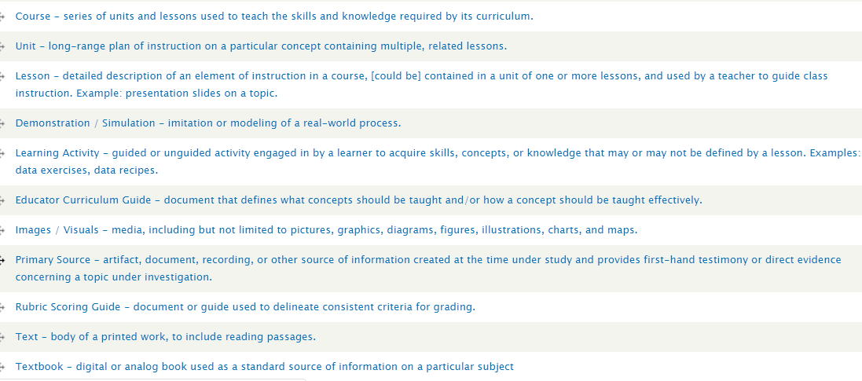
Seeking Learning Resource Types, such as:
44

Slide 45
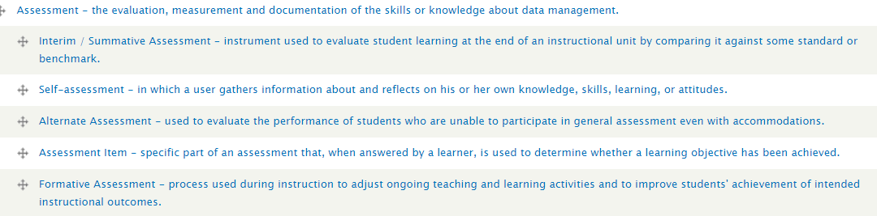
Seeking educational resource types, continued:
45

